Slide 1
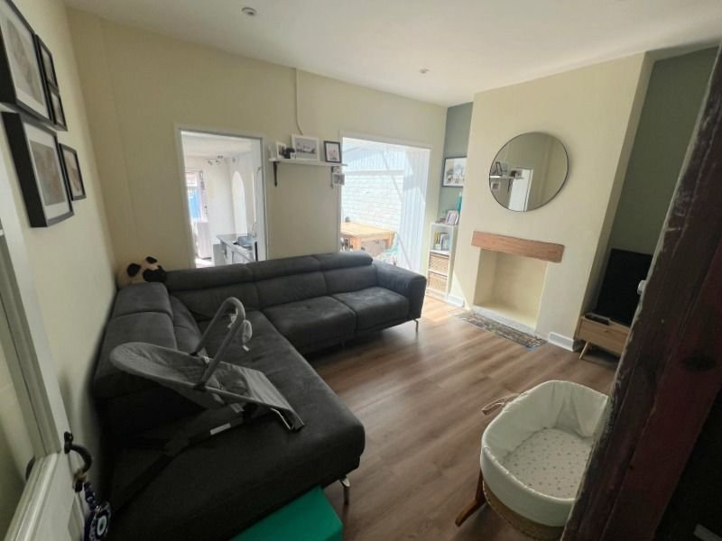
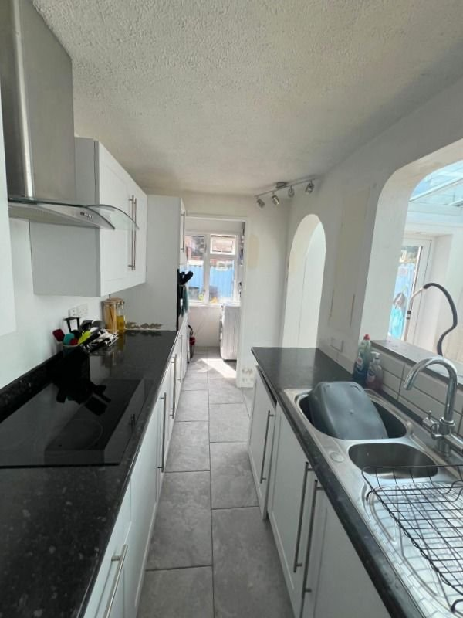
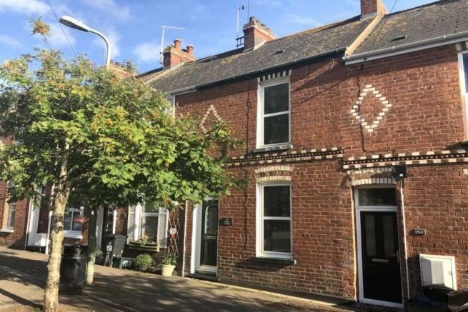
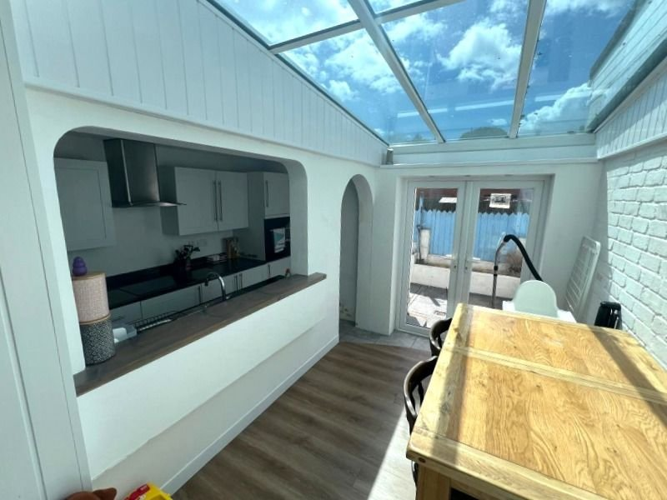
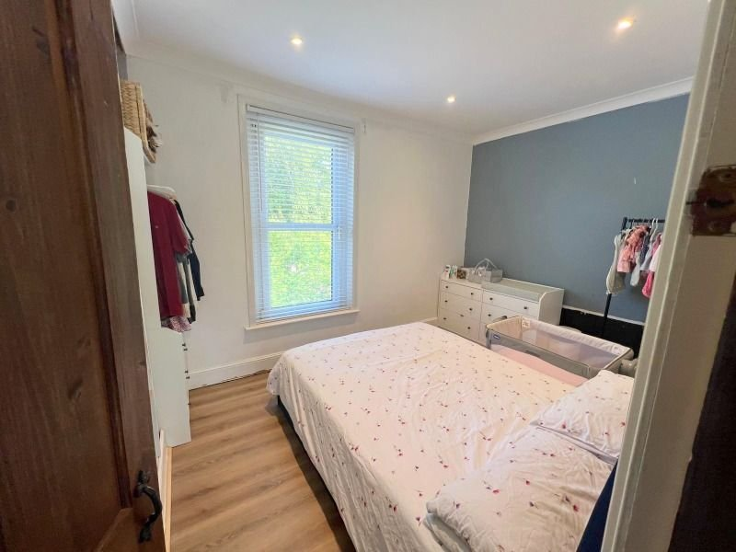
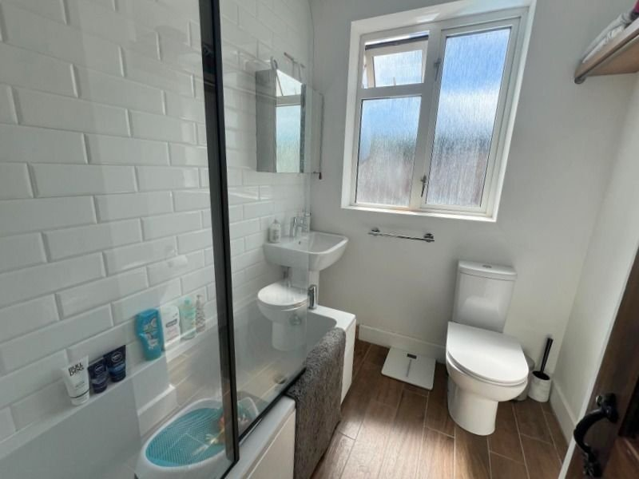
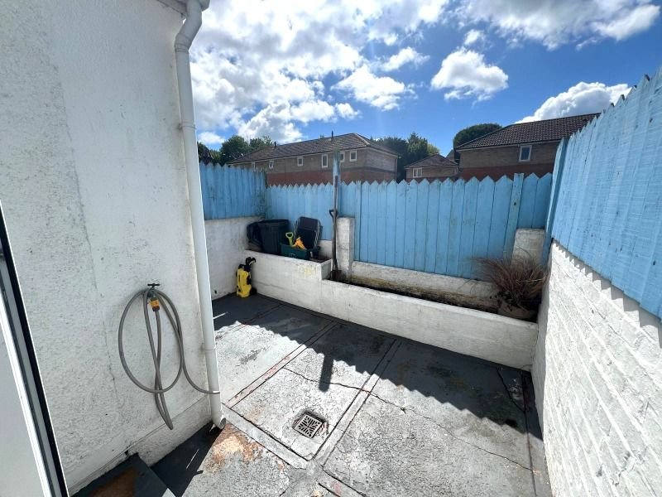
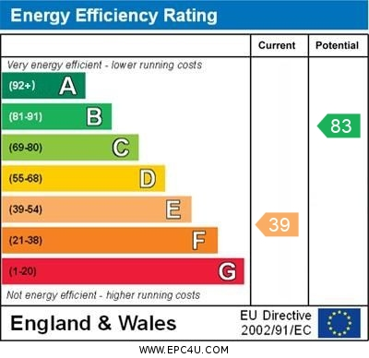
www.pennys.net
156 Withycombe Village Road, Exmouth, EX8 3BA
GUIDE PRICE £240,000
TENURE Freehold
Period Terrace House Conveniently Situated Close To Amenities Including Well Regarded Primary School, Shopping Parade, Making The Property An Ideal Family/First Time Purchase
Lounge * Dining/Family Room * Family/Play Room * Kitchen * Utility Room * Two Bedrooms * Bathroom/Wc * Second Floor Attic Room * Courtyard Garden * Viewing Recommended
Pennys Estate Agents Limited for themselves and for the vendor of this property whose agents they are give notice that:- (1) These particulars do not constitute any part of an offer or a contract. (2) All statements contained in these particulars are made without responsibility on the part of Pennys Estate Agents Limited. (3) None of the statements contained in these particulars are to be relied upon as a statement or representation of fact. (4) Any intending purchaser must satisfy himself/herself by inspection or otherwise as to the correctness of each of the statements contained in these particulars. (5) The vendor does not make or give and neither do Pennys Estate Agents Limited nor any person in their employment has any authority to make or give any representation or warranty whatever in relation to this property.
PENNYS ESTATE AGENTS
2 Rolle House, Rolle Street, Exmouth, Devon, EX8 2SN
Tel: 01395 264111 EMail: help@pennys.net

Slide 2
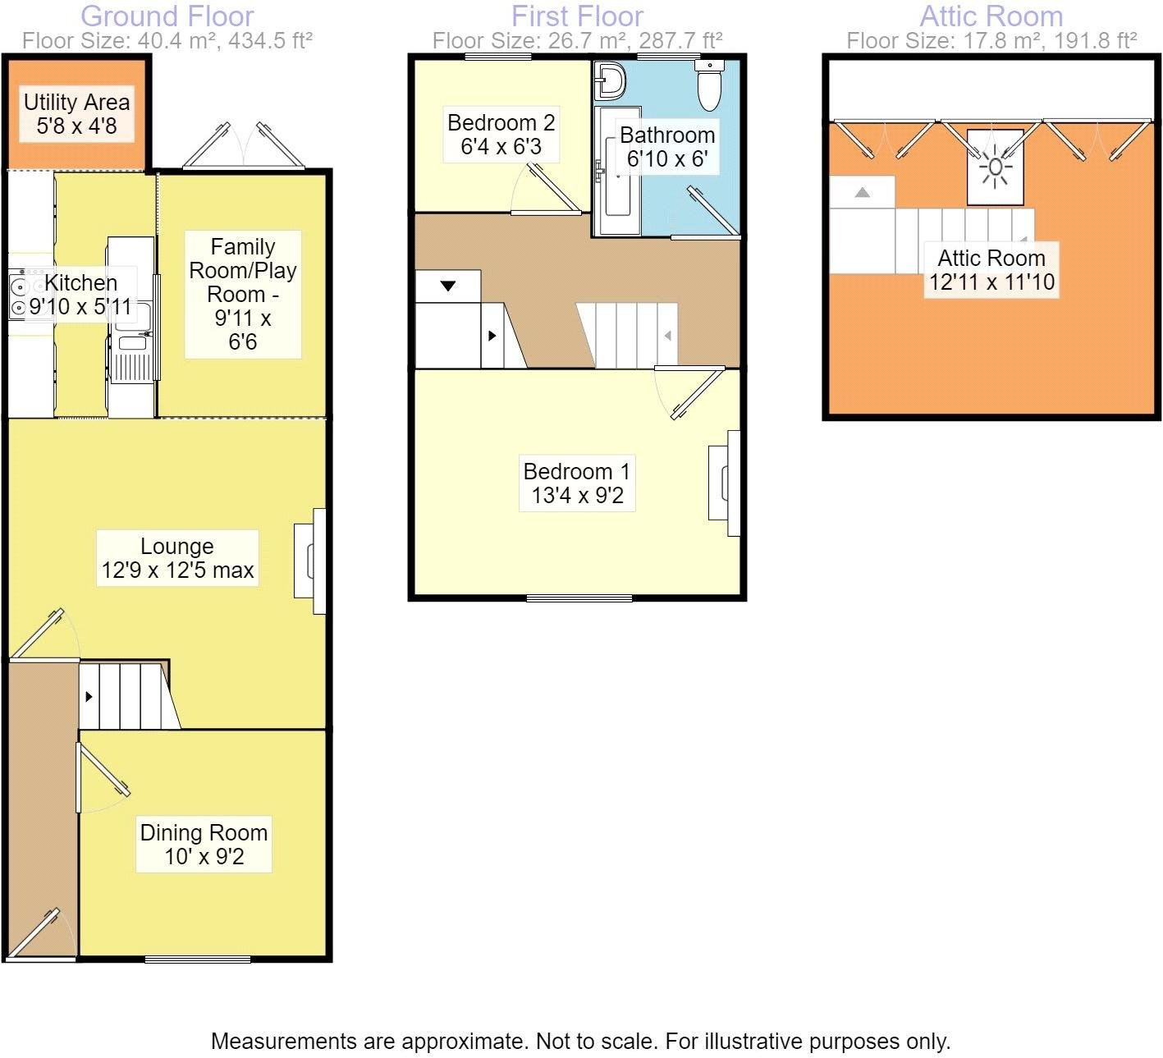
156 Withycombe Village Road, Exmouth, EX8 3BA
THE ACCOMMODATION COMPRISES: Part glazed front door giving access to:
RECEPTION HALL: With staircase rising to first floor.
DINING/FAMILY ROOM: 3.05m x 2.79m (10'0" x 9'2") A versatile room with double glazed window to front aspect, feature wood flooring, TV point.
LOUNGE: 3.89m x 3.78m (12'9" x 12'5") With feature chimney recess, TV point, feature wood flooring, opening to:
FAMILY/PLAY ROOM: 3.02m x 1.98m (9'11" x 6'6") With double glazed double doors opening onto the rear garden, feature wood flooring and opening through to:
KITCHEN: 3m x 1.8m (9'10" x 5'11") With a range of patterned worktops with cupboards and drawer units beneath, splashback surrounds, inset sink unit with mixer tap, built-in oven, four ring electric hob with stainless steel chimney style extractor hood over with light, built-in oven, tiled floor, opening to:
UTILITY ROOM: 1.73m x 1.42m (5'8" x 4'8") Useful area with plumbing for automatic washing machine.
FIRST FLOOR LANDING: With staircase rising to second floor.
BEDROOM 1: 4.06m x 2.79m (13'4" x 9'2") With double glazed window to front elevation.
BEDROOM 2: 1.93m x 1.91m (6'4" x 6'3") With double glazed window to rear aspect.
BATHROOM/WC: Fitted with a modern suite comprising bath with shower and screen, pedestal wash hand basin with mirror over, WC with push button flush, double glazed window.
SECOND FLOOR ATTIC ROOM: 3.94m x 3.61m (12'11" x 11'10") A useful room with velux windows, access to eaves storage space.
OUTSIDE: To the rear of the property is an enclosed courtyard garden. Outside tap.
FLOOR PLAN:

